Slide 1

University Management System.
Team Members:
Manogna Pallapothu(002776168)
Padma Anaokar(002727445)
Yash Pawar(002747371)

Slide 2

Problem Statement
In the ever-evolving landscape of higher education, the need for an efficient University Management System is paramount. This project aims to develop a comprehensive JavaFX-based system that focuses on essential functionalities, including student CRUD operations, admin tasks, and grades management.
The successful implementation of the University Management System with a focus on student CRUD operations, admin functionalities, and grades management aims to enhance the efficiency and accuracy of university administrative processes.

Slide 3
Topics Covered:
Inheritance
Polymorphism
Lambdas
Exception Handling
Interface
Collections
Encapsulation
Regular Expression
Abstraction
Generics

Slide 4
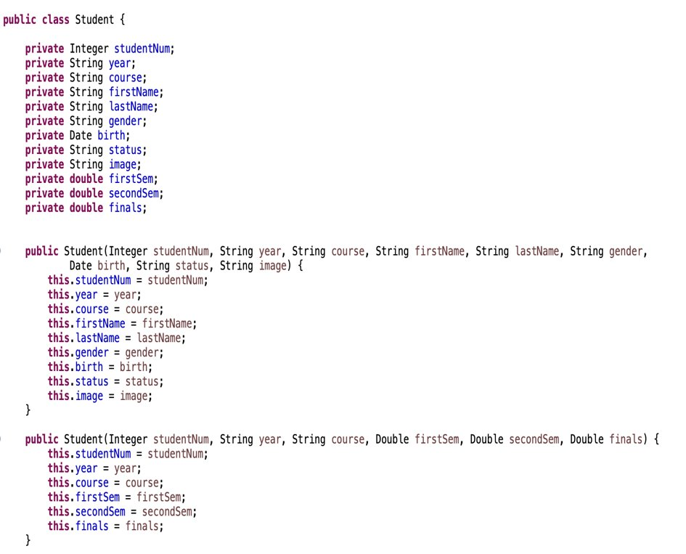
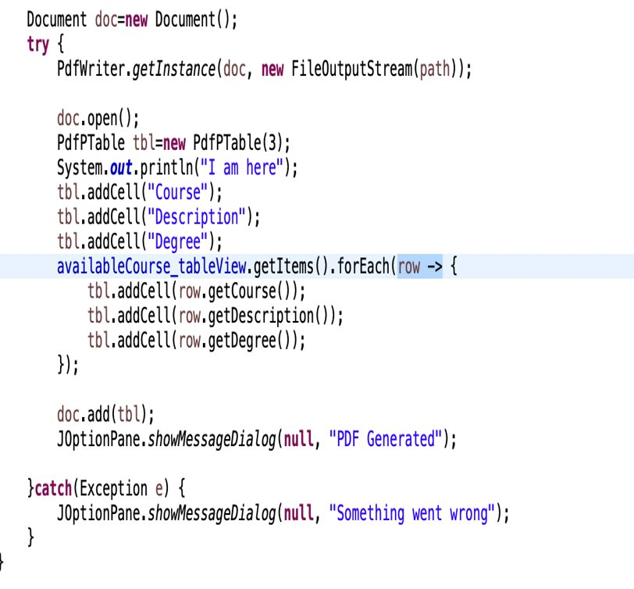
Encapsulation:
Lambda Expression:

Slide 5
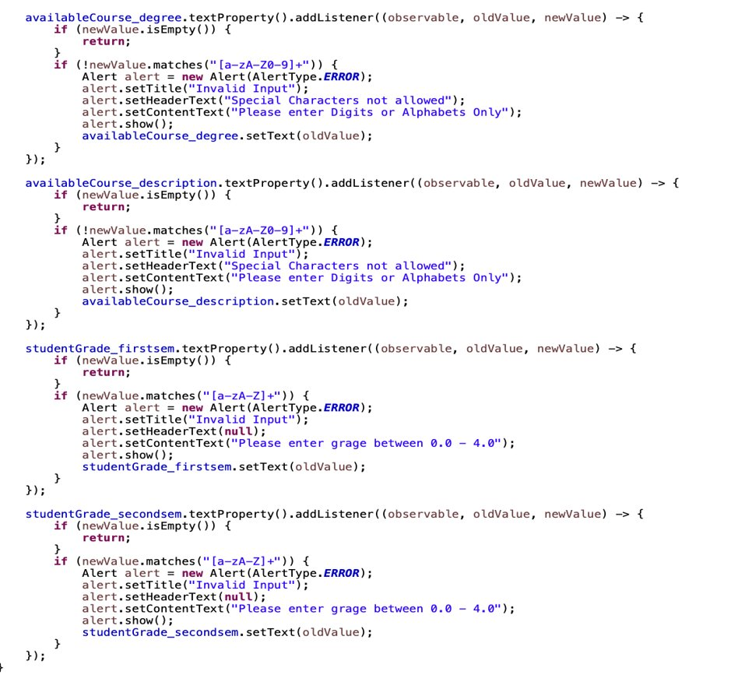
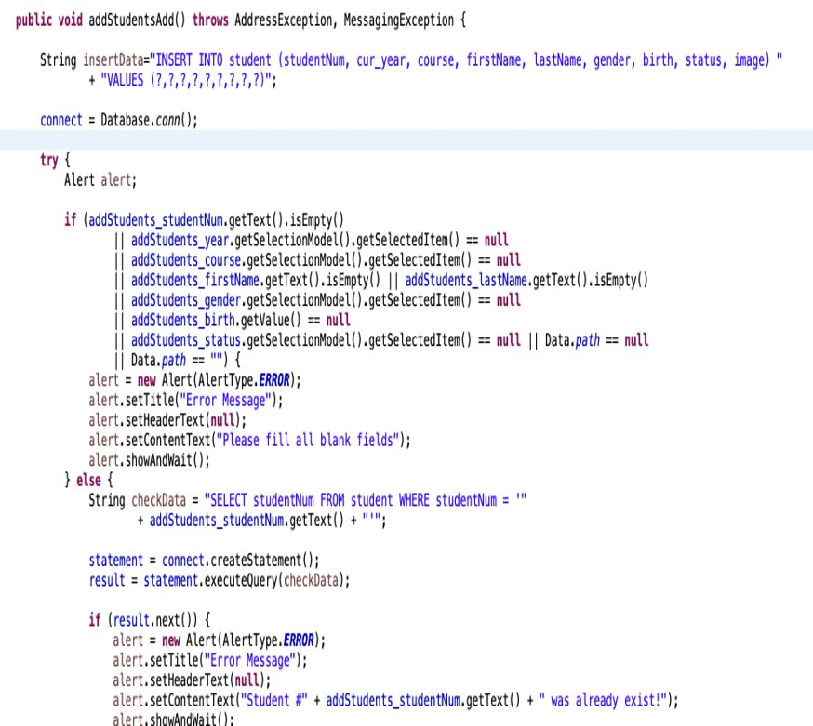
Regular Expression:
Exception Handling:

Slide 6




Tools Used:

Slide 7
Overview:
Developed multi-user logins including Students and Admins.
Used libraries like: mysql connector , font-awesome, jfreechart, itext, javaxmail
Used JDBC to establish connection to the database.

Slide 8
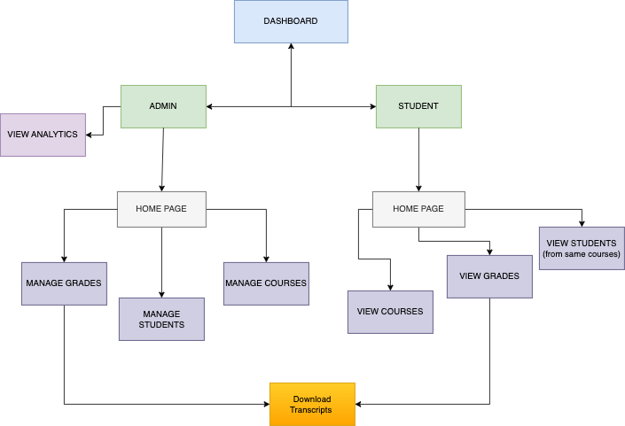
System Diagram:

Slide 9
System Architecture:
MODEL:
1. COURSE
2. STUDENT
3. GRADES
4. DATA
VIEW:
Login.fxml
Dashboard.fxml
Student.fxml
ARCHITECTURE:
DashboardController
LoginController
StudentController

Slide 10

Database and Schema:
Four tables:
Student: id, studentNum, year, course, year, course, firstName, lastName, gender, birth, status, image
Courses: id, course, description, degree
Grades: id, studentnum, year, course, first_sem, second_sem, final
Admindata: id, username, password
Created Database (studentDatabase) class which uses JDBC driver to connect to the database and to perform CRUD operations

Slide 11
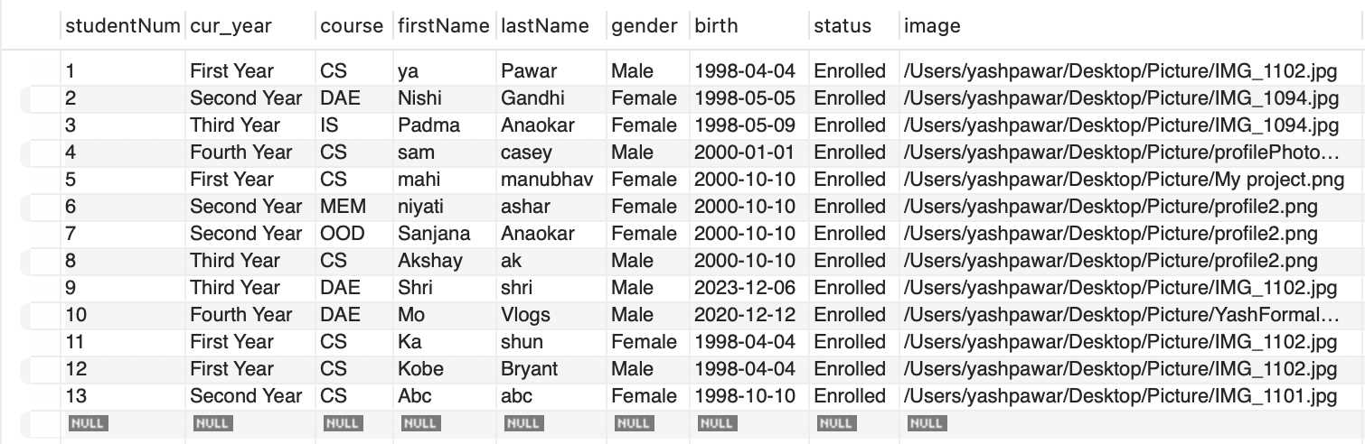
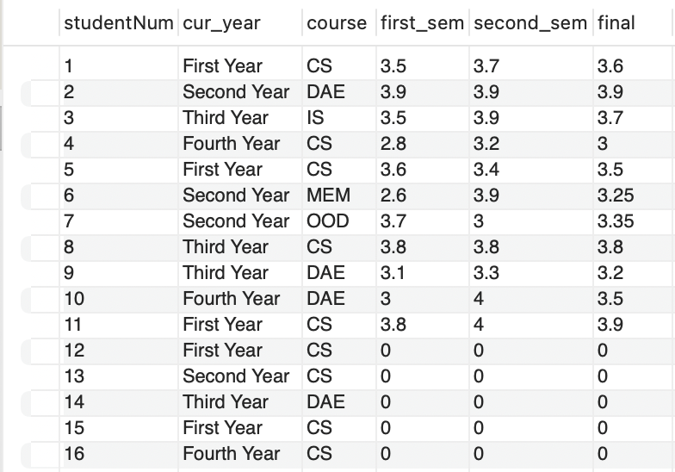
Database Schema Sample:
Student Table:
Grades Table:

Slide 12
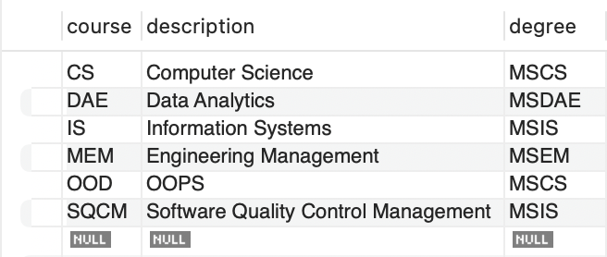
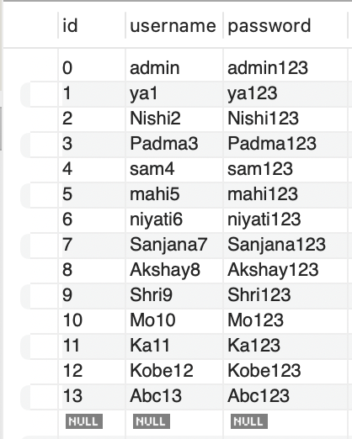
Database Schema Sample:
Course Table:
Admin Table:

Slide 13
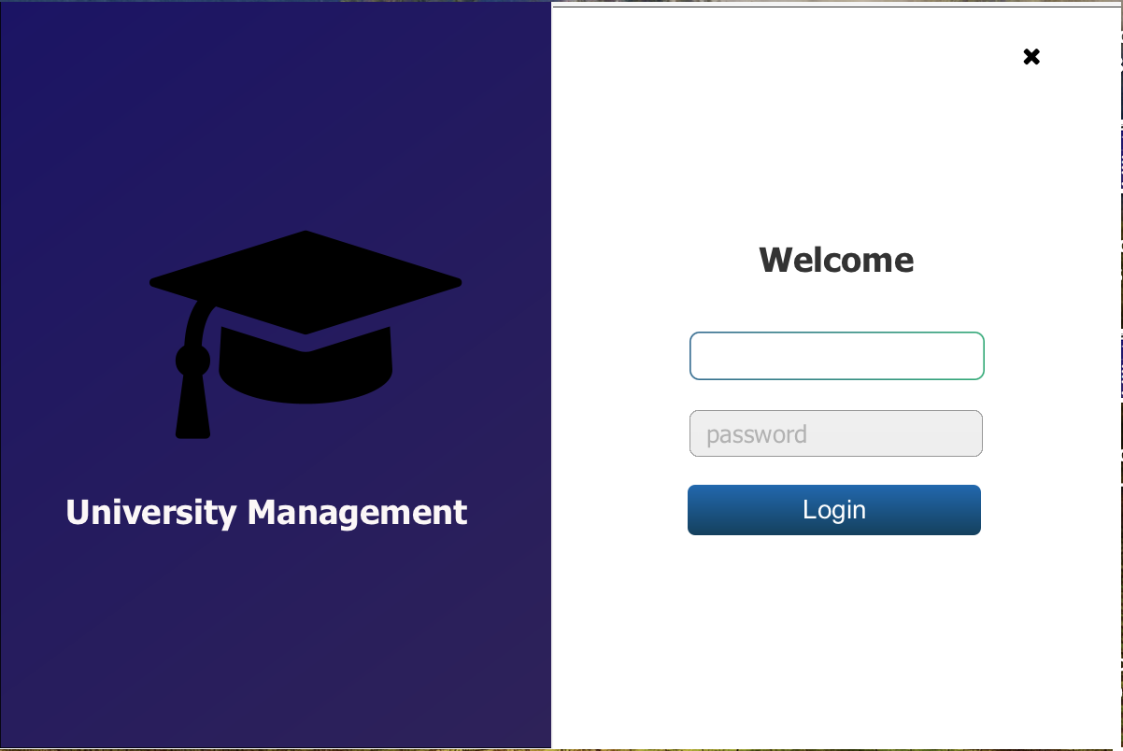
Implementation:
Admin
Login : Admin can login to their account using the admin credentials which are stored in admin table. Admins credentials are fetched from the database and is validated
2. Roles: Can add/update/delete/view students, courses and grades.
3. Admin Receives an Email, whenever a student login into the portal

Slide 14
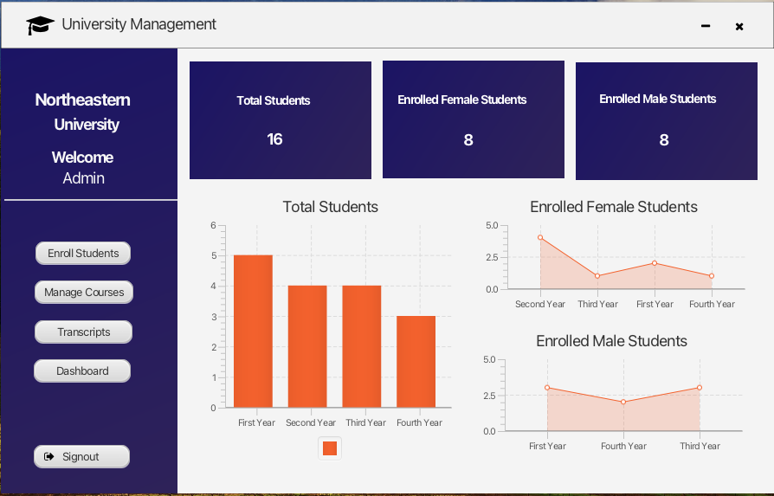
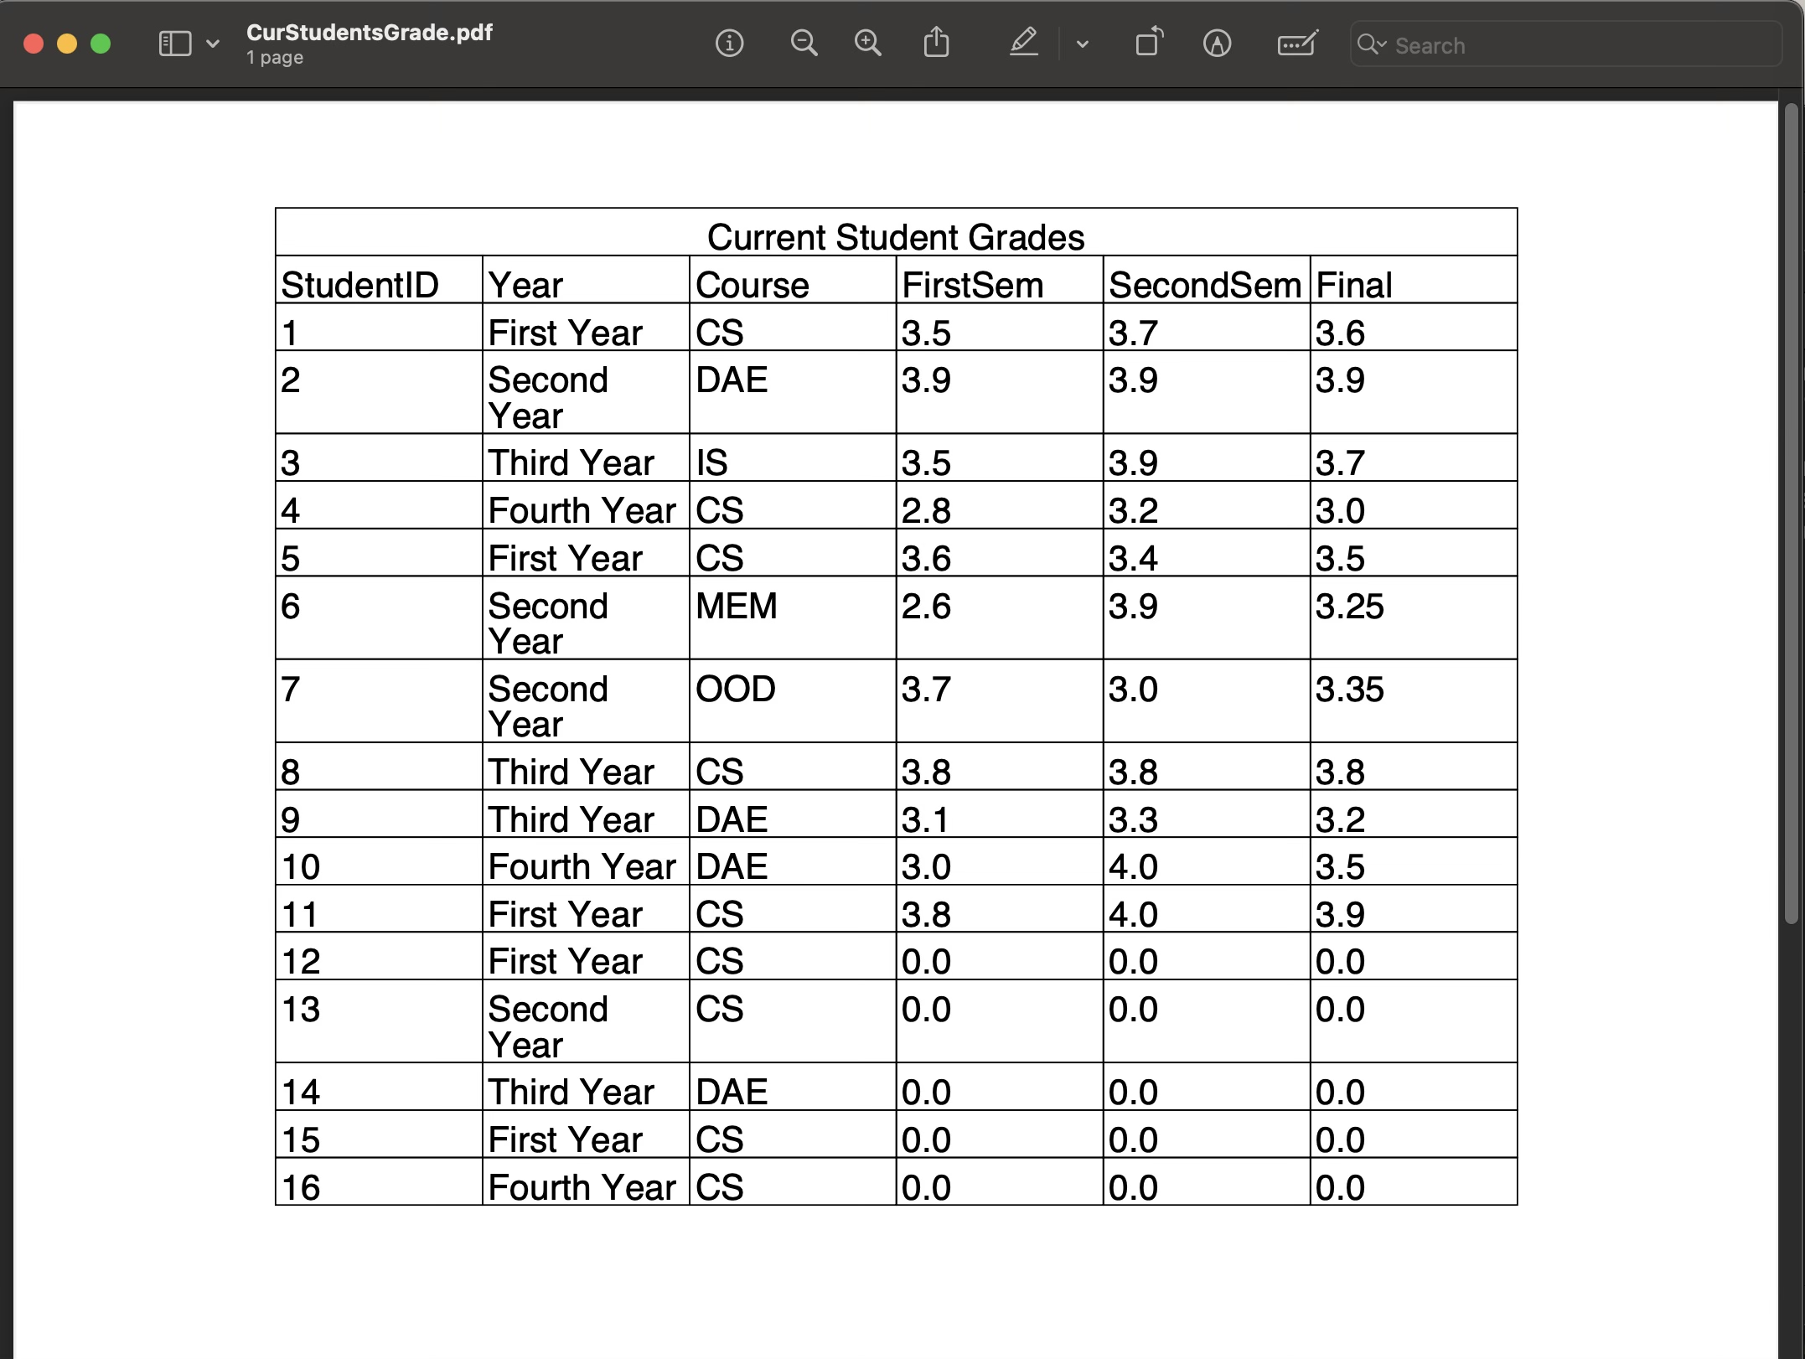
Implementation
Admin
4. View graphs: Admin can see total number of students enrolled per year in a form of a bar graph. Also, can filter the students based on gender.
5. Generate a report: Admin can generate a report of current student data, available courses data and student grades.

Slide 15
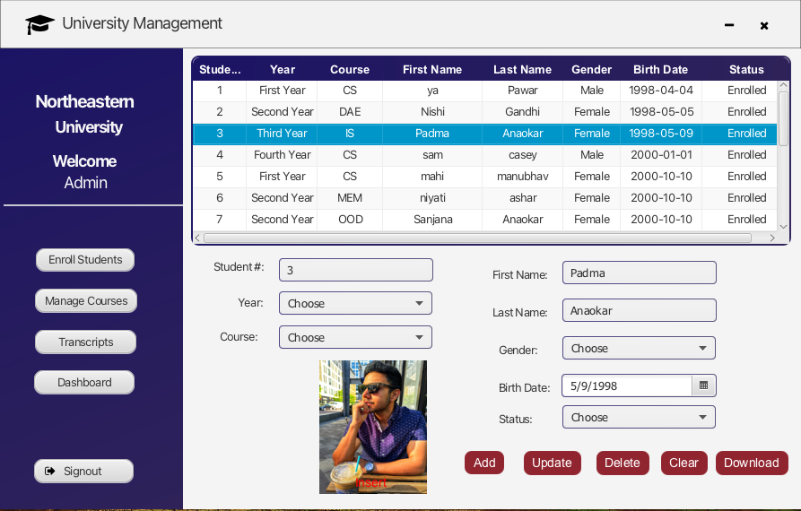
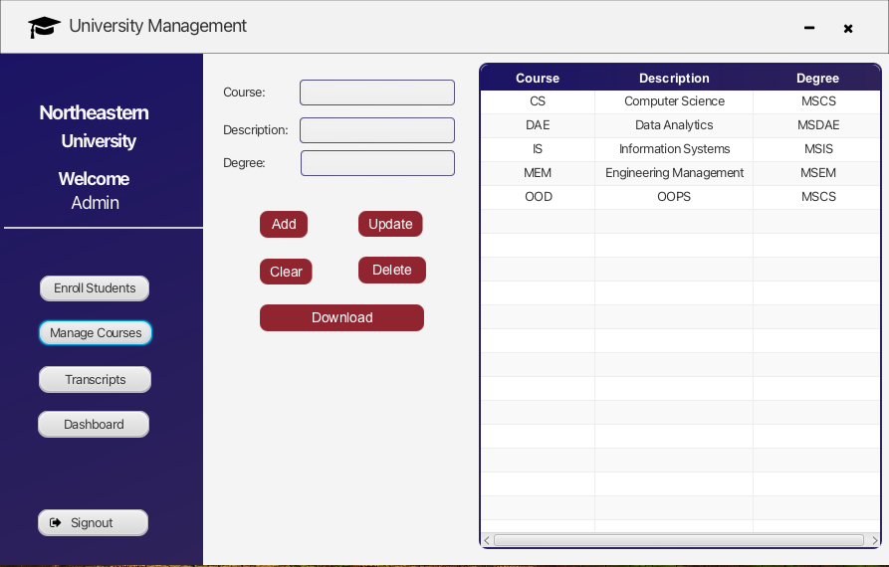
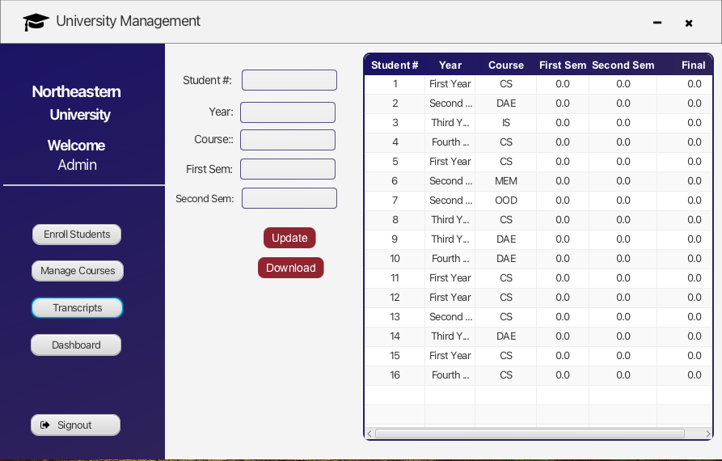
Implementation
Admin
6: Add/Update/Delete/View Student: By clicking on Enroll Student button on dashboard
7: Add/Update/Delete/View Courses :By clicking on Manage Courses button on dashboard
8: Admin can enter grades for Students by clicking on Transcript button

Slide 16
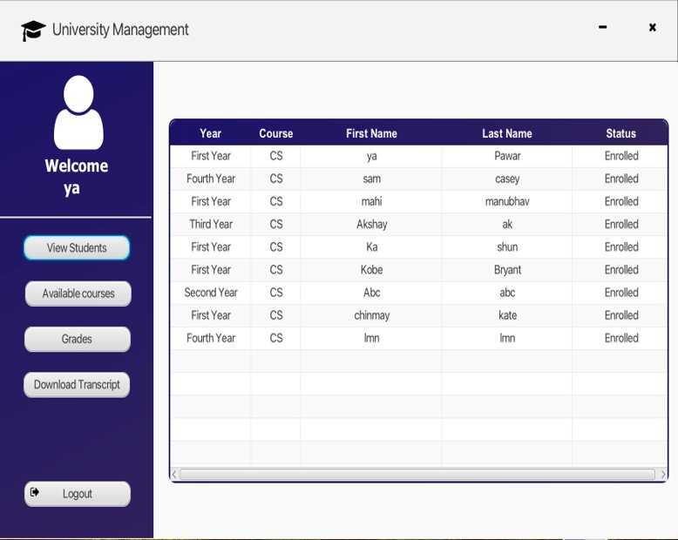
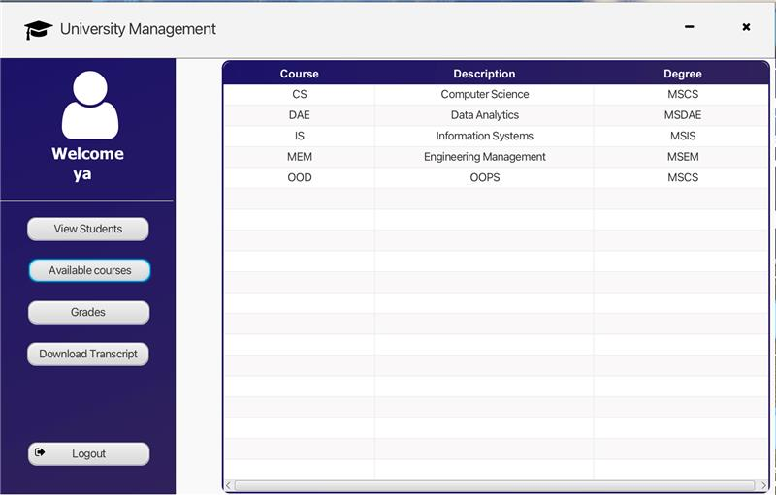
Implementation
STUDENT:
Login : Student can login to their account using the credentials which are stored in admin table.
View other students: from same course by clicking on View Students
Can view available courses.
Can view their transcripts and download it.

Slide 17
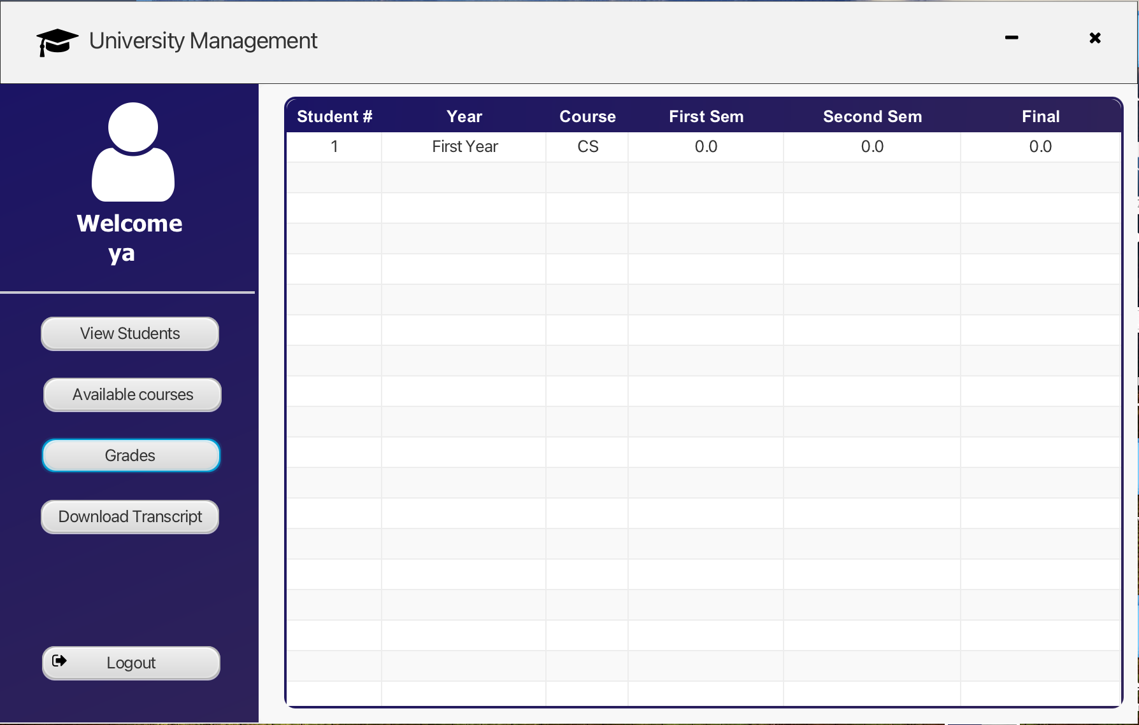
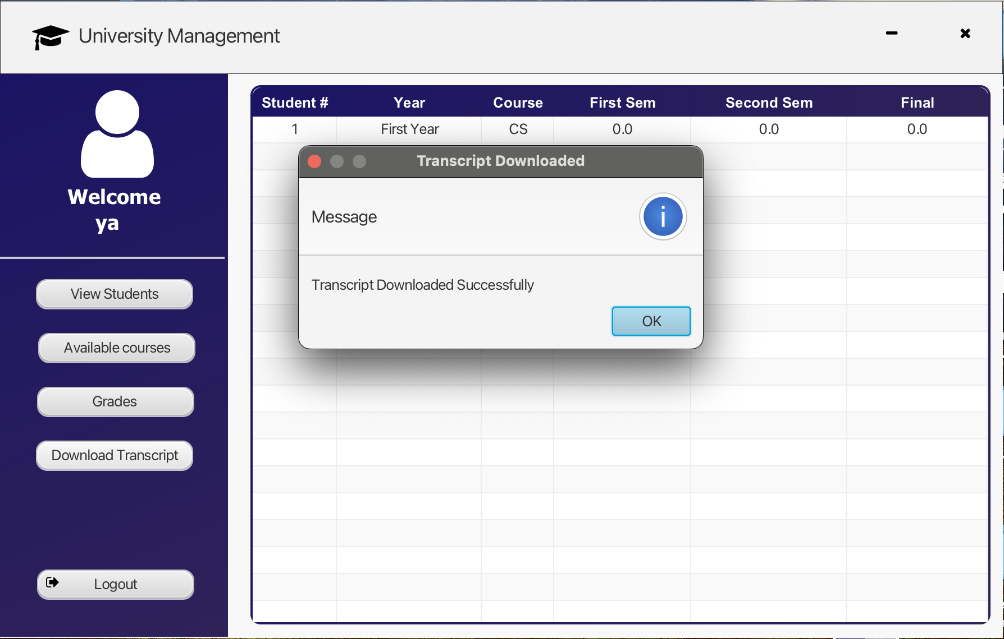
Implementation

Slide 18
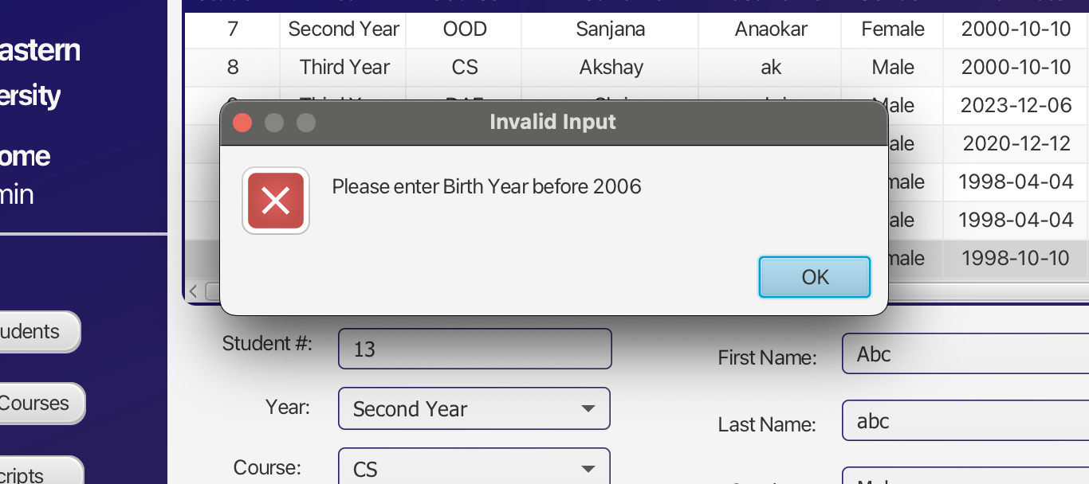
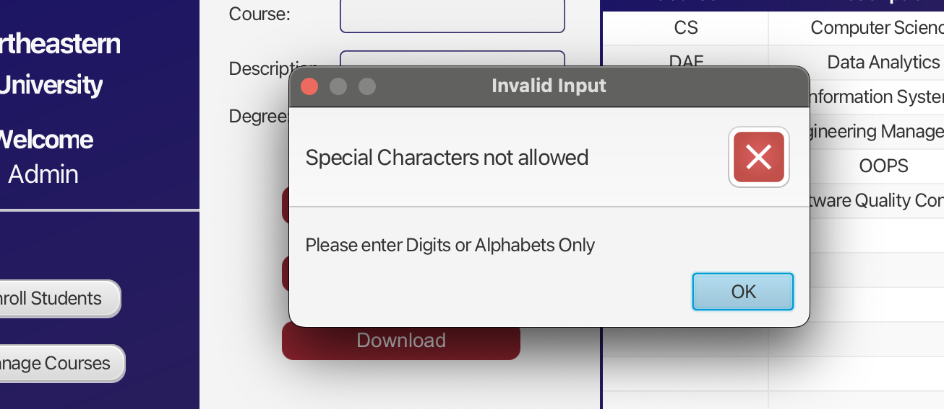
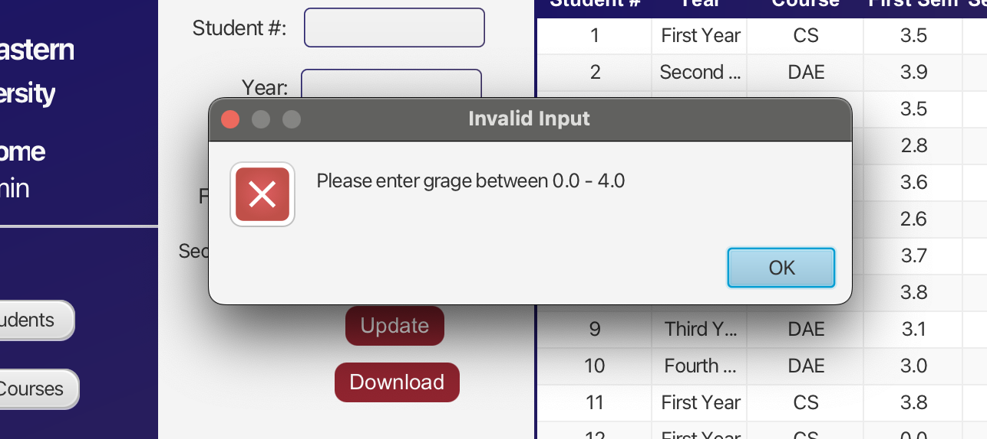
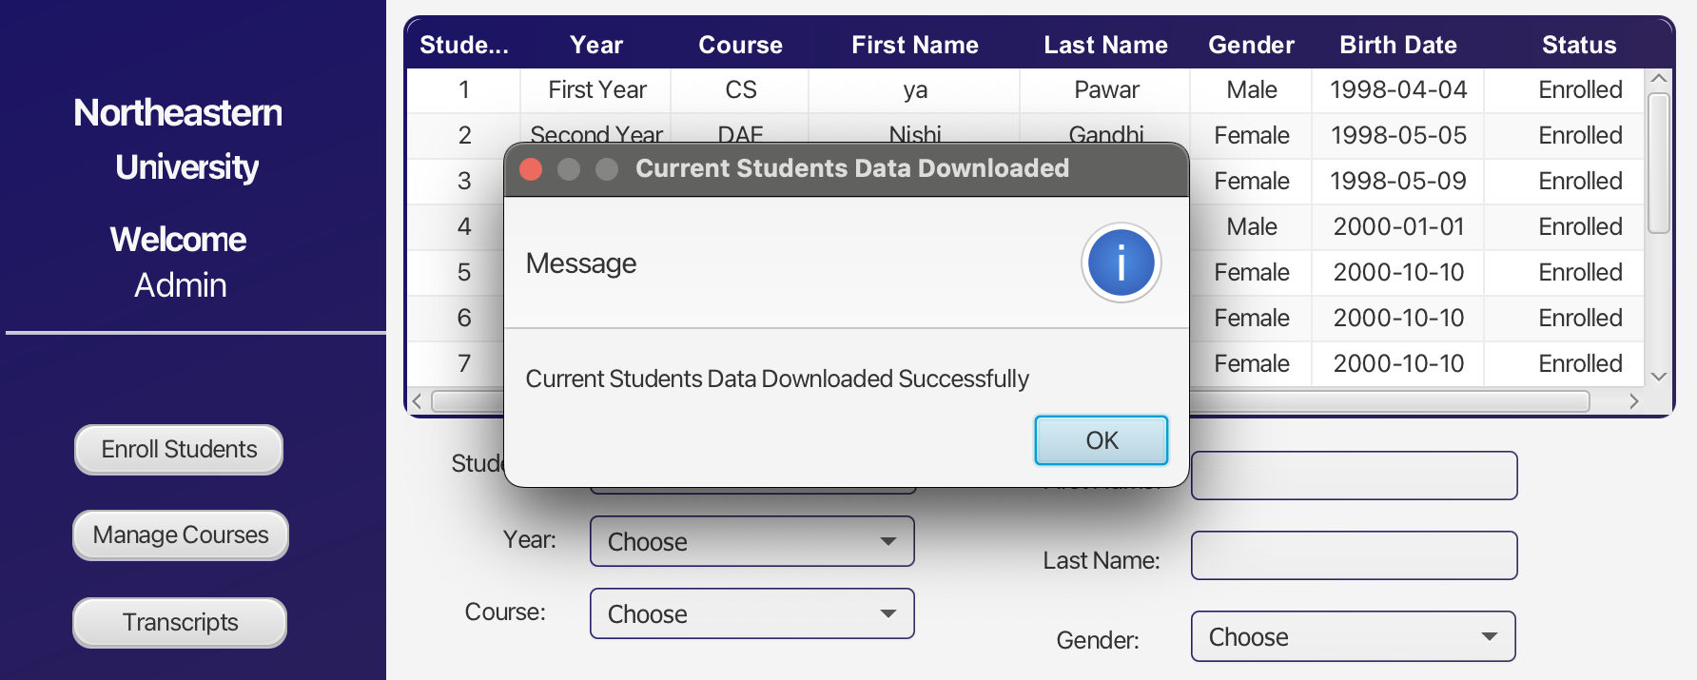
Validations:

Slide 19
Key Learnings:
Successfully implemented database integration into the project.
Demonstrated a thorough understanding of the end-to-end workflow connecting the front-end and back-end components.
Acquired skills in storing and retrieving user information from the database.
Implemented dynamic representation of data through Bar charts and Area charts.
Applied object-oriented programming concepts more effectively in the project.
Demonstrated adept use of Java collections, particularly lists and sets.
Learned and applied the usage of collections in JavaFX, with a focus on Observable Lists.

Slide 20

Problems Encountered:
We encountered some configuration errors while working on the project simulteanously.
JDBC connection was confusing at first but we were able to overcome.
Ensuring proper mapping between Java objects and database tables.

Slide 21
Future Scope:
Including other aspects like attendance management and enrollment management could be implemented.
Dining Services to check meal-swipes and exchange meal swipes can also be implemented.
Networking functionalities for students could be incorporated, enabling communication among peers. Features such as chat and messaging could be integrated, facilitating student interaction for online classes and collaborative engagement.

Slide 22
Contribution:
Padma Anaokar: Database integration, login page, student view page, Add courses page, Downloading Transcripts, Graphs and Analysis
Manogna Pallapothu: UI design, Cascading style sheets, Add student Page, Database entities, CRUD operations, Downloading Courses, Graphs and Analysis
Yash Pawar: System design diagram, System design, Dashboard page, Student Grades page, Crud operations, Email notification, Graphs and Analysis

Slide 23

Conclusion:
Applied object-oriented principles, including inheritance, abstraction, polymorphism, interfaces, and generics, to enhance code efficiency.
The successful implementation of the University Management System, emphasizing student CRUD operations, admin tasks, and grades management, is expected to greatly improve the precision and efficiency of university administrative processes.

Slide 24

Thank you!
Team Members:
Manogna Pallapothu
Padma Anaokar
Yash Pawar

